Slide 1
Gradient Descent

Slide 2
What is gradient descent
Gradient Descent is a first-order optimization technique used to find the local minimum or optimize the loss function. It is also known as the parameter optimization technique.
We can find value of m and b to get loss minimum but if the data is very big then calculating inverse of matrix will be very time consuming.So in high dimension that approach fail.
Gradient descent is a algorithm to which if we will give a differentiable function then it will calculate the local minima(minimum) of that function.

Slide 3
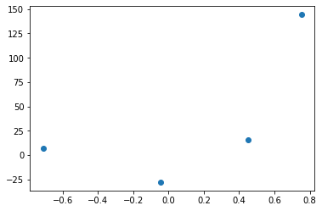

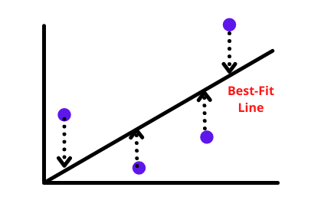


Intution
Lets suppose we have taken dataset having 2 columns 4 rows of CGPA and LPA of 4 students.
We need to draw a best fit line using
gradient descent
A best fit line is one which do minimum error in
Y axis.
Also loss function is and
here loss function is dependent on m,b
Basically this function has 2 tuning knobs m and b

Slide 4

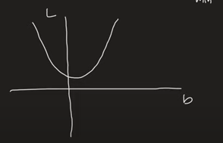
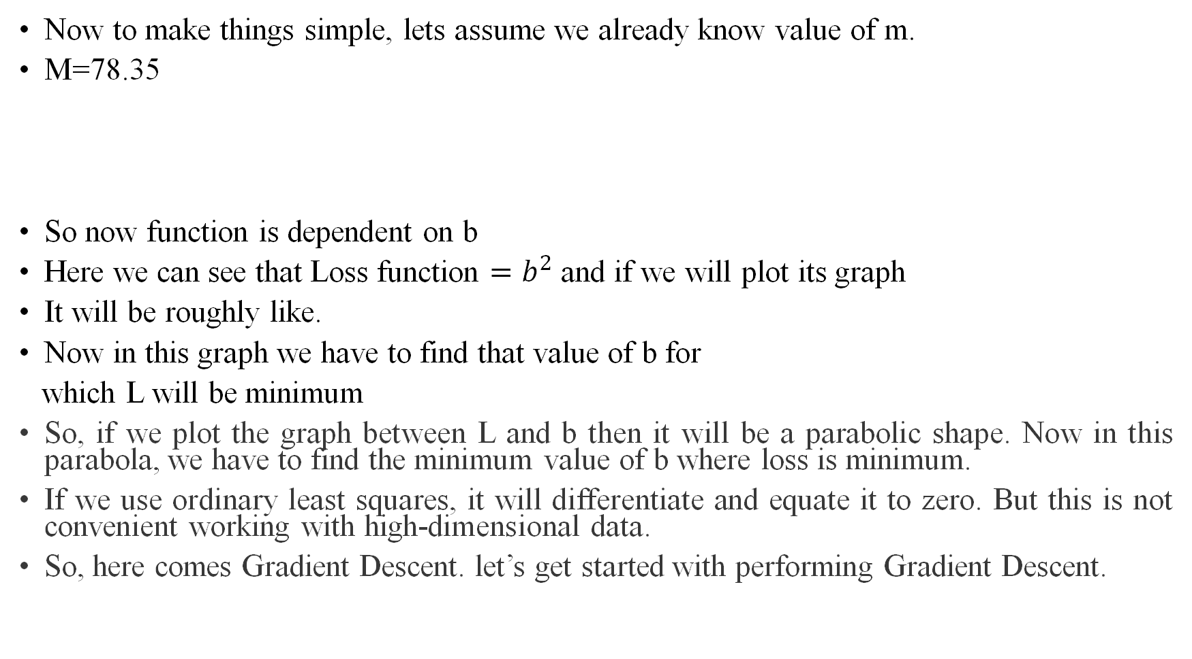
Now to make things simple, lets assume we already know value of m.
M=78.35
So now function is dependent on b
Here we can see that Loss function $=b^{2}$ and if we will plot its graph
It will be roughly like.
Now in this graph we have to find that value of b for
which L will be minimum
So, if we plot the graph between L and b then it will be a parabolic shape. Now in this parabola, we have to find the minimum value of b where loss is minimum.
If we use ordinary least squares, it will differentiate and equate it to zero. But this is not convenient working with high-dimensional data.
So, here comes Gradient Descent. let’s get started with performing Gradient Descent.

Slide 5
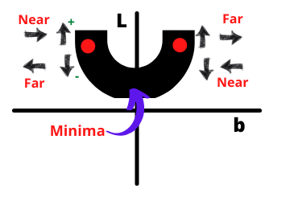
Select a random value of b
we select any random value of b and find its corresponding L value. Now we want to converge it to the minimum.
On the left side, if we increase b then we are going towards minimum and if decreasing then we are going away from the minimum. On the right side, if we decrease b then we are going closer to a minimum and on increasing we are going away from the minimum. Now how would I know that I want to go forward or backward?

Slide 6
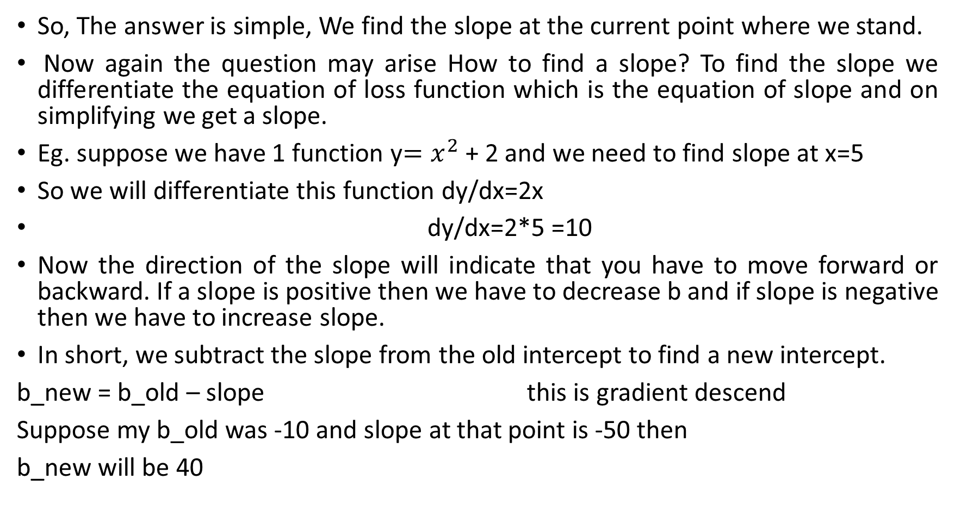
So, The answer is simple, We find the slope at the current point where we stand.
Now again the question may arise How to find a slope? To find the slope we differentiate the equation of loss function which is the equation of slope and on simplifying we get a slope.
Eg. suppose we have 1 function y$=x^{2}$ + 2 and we need to find slope at x=5
So we will differentiate this function dy/dx=2x
dy/dx=2*5 =10
Now the direction of the slope will indicate that you have to move forward or backward. If a slope is positive then we have to decrease b and if slope is negative then we have to increase slope.
In short, we subtract the slope from the old intercept to find a new intercept.
b_new = b_old – slope this is gradient descend
Suppose my b_old was -10 and slope at that point is -50 then
b_new will be 40

Slide 7
Here one thing to notice is earlier we were at -10 and then we reach to 40 ,which is a big jump.
So every time if we subtract slope then transition is too big and we keep on doing zig zag movement and never reach minima
So we will transform the equation
b_new = b_old – slope to b_new = b_old – (learning rate)slope
Generaly learning rate is 0.01
So now if we are at -10 and slope is -50
Then b_new= -10 +0.01*50=-10+0.5=-9.5
Then we will calculate slope at -9.5

